Slide 1

TRICS
More than Just
Trip Generation
Owen Edwards
Project Manager
TRICS Consortium Ltd
Notes:
Good morning, everyone.
My name’s Owen, I’ve been with TRICS for 11 years now and have been Project Manager for almost nine months.
This morning, I thought it would be nice to talk to you all about what TRICS does.

Slide 2
TRICS is just a trip rate calculation
tool, right?
Yes? No! Maybe??
Notes:
TRICS is just a trip rate calculation tool, right? Yes? No! Maybe??
Let’s find out what everyone here in this room has used TRICS for and let’s see if I can surprise anyone with something they didn’t know.
First, I’d like to know how many people in this room are current members of TRICS and therefore licence holders. If you are, please raise your hand. Now please put your hand down if you *have* run a trip rate calculation in TRICS. I’m expecting almost everyone to put their hands down, but we may have one or two new people to TRICS here who have yet to carry out a trip rate calculation. Anyone with their hands remaining in the air are people who have access to TRICS but have not yet had the chance to use it in their job role.

Slide 3

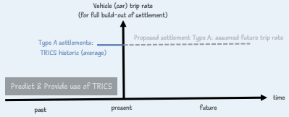
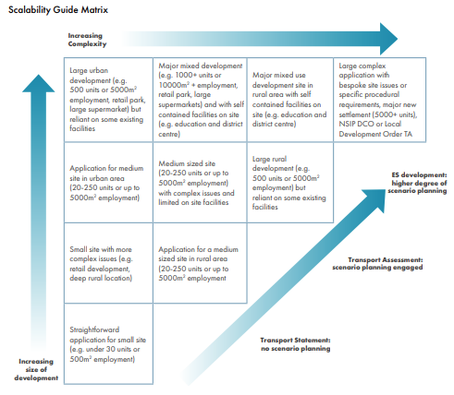
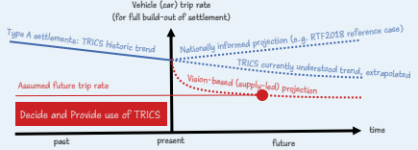
Decide & Provide
The Decide & Provide Guidance Note was published in February 2021.
TRICS currently has 9,238 survey days in the database from 1981 to present day.
Over 2,500 of these surveys are multi-modal in nature, beginning in the year 2000.
Presentations from November’s 2023 User Meeting are available on the TRICS website.
Notes:
Let’s start with the Decide & Provide Guidance Note published by TRICS in February 2021.
At this point, please could I ask those who have read the guidance note, or at least the summary, to put their hands up.
The purpose of publishing the guidance note was to raise awareness of the Decide & Provide approach, as well as to increase knowledge of it. We were also keen to help support and assist with the practical implementation of the approach, and this has been seen, particularly with Oxfordshire County Council. Another purpose was to help many of the people in this room to use the Decide & Provide approach in the preparation, and review of, transport appraisals, including TAs and TSs.
We also wanted to maximise the use of our huge wealth of survey data to its best effect. You may not realise TRICS now has 9,238 survey days in the database, dating all the way back to 1981. As of next week, there will be even more data added as we release another batch of survey days to the public.
A common misunderstanding of TRICS is it simply provides *vehicles only* trip rate calculations but, since the year 2000, we’ve added over 2,500 multi-modal survey days to the system. This allows for historical trend data of all modes to be accounted for during the assessment process.
If a lot of this information is new to you, I would highly recommend visiting the Decide & Provide section of our website.

Slide 4
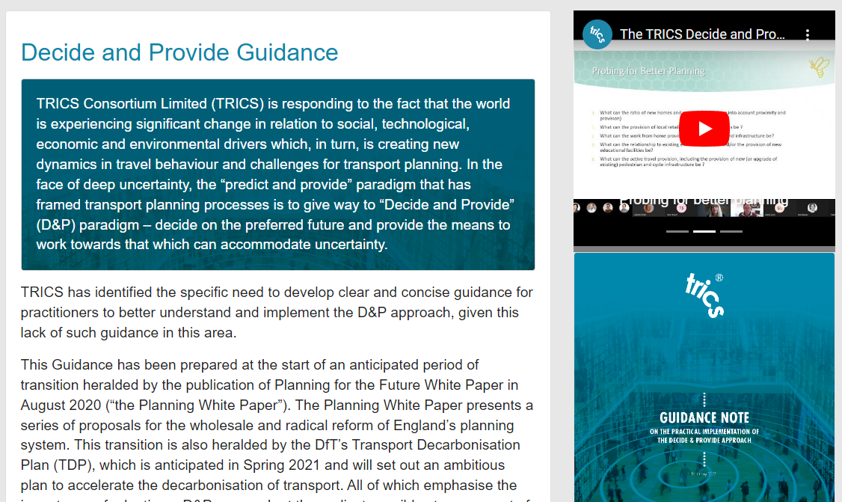

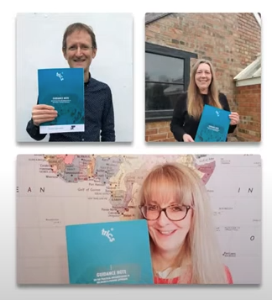
Decide & Provide
Notes:
On the Decide & Provide page of our website, you can find a 9-page PDF summary of the guidance note, as well as a link to download the full 68-page PDF document.
If you’d like a physical copy for your office, we’ve brought some along with us today so please ask a member of the team in the first break and we can provide you with one.
Also available on the Decide & Provide page of the website is a link to a customisable Historic Trends Excel spreadsheet template and embedded in the page are three videos hosted on our YouTube channel.
These three videos explore a Scene Setting Introduction, an overview of the Decide & Provide document and the use of TRICS within Decide & Provide.
The videos range from 12 to 25 minutes and are a useful way to expand your Decide & Provide knowledge, particularly if you take in information better through listening than reading, like me!
Finally, you can also find the Decide & Provide related presentations given at November’s 2023 User Meeting to download. One was written from Oxfordshire County Council’s perspective and another from Somerset Council’s.

Slide 5
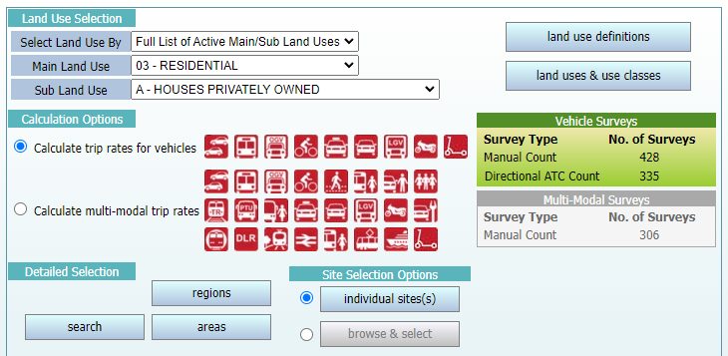
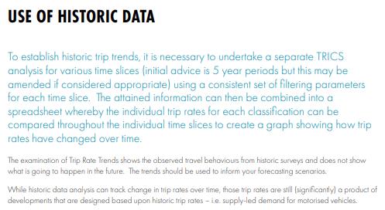
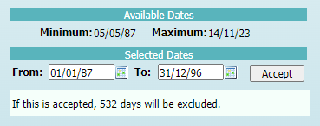
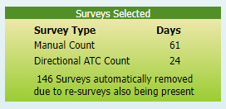
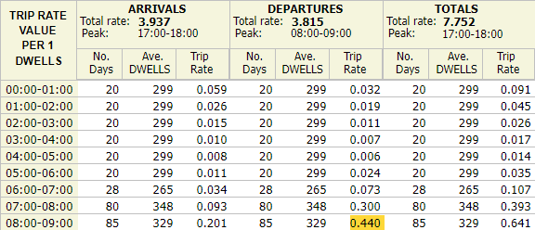
Historic Trends Capabilities
Notes:
Let’s look at a quick example of the wealth of data we have in the TRICS database, allowing for historic trend analyses to take place.
For example, the 03/A Houses Privately Owned land use sub-category, the most used land use type in the database, has over 750 survey days spanning 35 years.
Even when looking at the first 10 years of data, from 1st January 1987 to 31st December 1996, we have a very healthy number of 85 survey days to utilise.

Slide 6
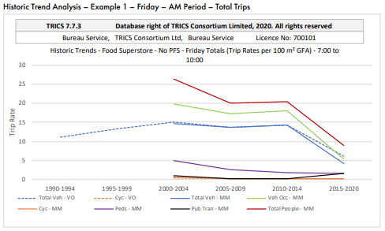
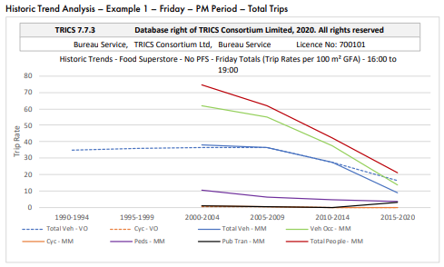
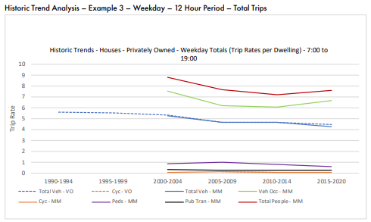
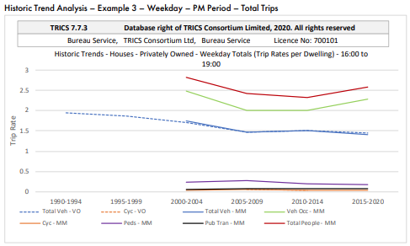
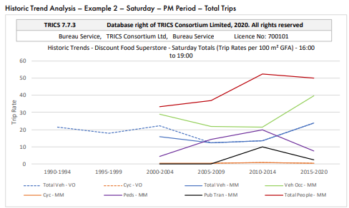
Changes in Travel Behaviour
Notes:
The origins of the Decide & Provide guidance document came about in 2019, when Changes in Travel Behaviour were investigated, using 30 years of TRICS data.
This guidance note was designed to inform TRICS users of the changes in travel behaviour over time and to discuss the implications of travel trends for TRICS users.
As you can see, here are some examples of 01/A (Food Superstore), 01/C (Discount Food Superstore) and 03/A (Houses Privately Owned) trends across six five-year time slices, ranging from 1989 to 2018.
The dotted blue lines are the vehicles only results and each solid line is a different representation of a particular mode, with blue being Total Vehicles, green Vehicle Occupants and red Total People.
The other three solid lines are public transport or active travel options.
As you can see from the graphs on the screen, one of the overall reflections of the report was there has been a decline in car trip rates recorded in TRICS across the time periods from 1998 onwards.
Another reflection was it appears that the historic TRICS data is reflecting the national travel behaviour trends at a local level as well as the increase in pedestrian trips and public transport trips having positive implications for planning sustainable transport sites in the future.

Slide 7
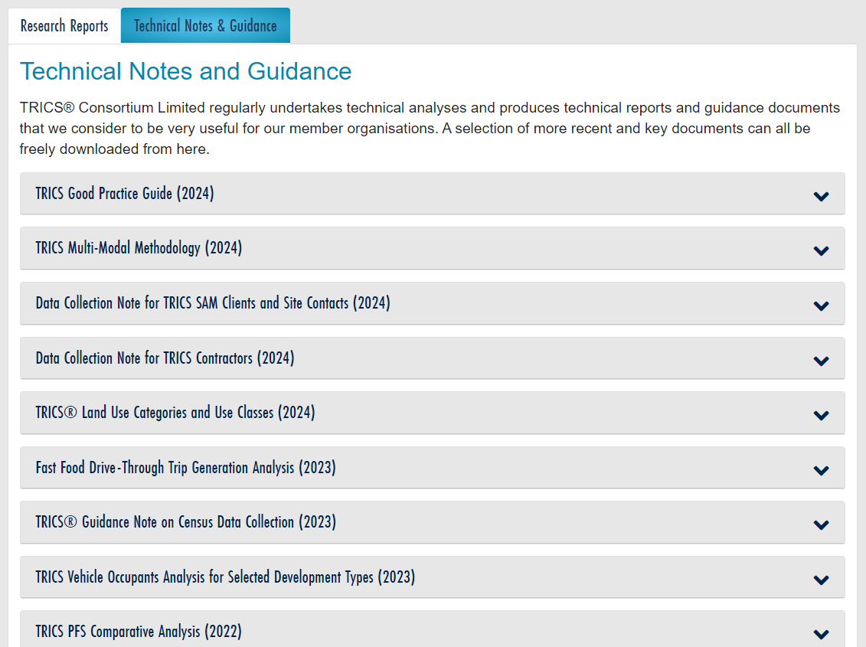
Technical Notes
Notes:
Next, I’d like to talk about the technical notes we publish, all of which can be found on our website for download.
As you can see, we regularly publish documents on this page and I’m going to briefly go through a summary of a handful of them now.

Slide 8
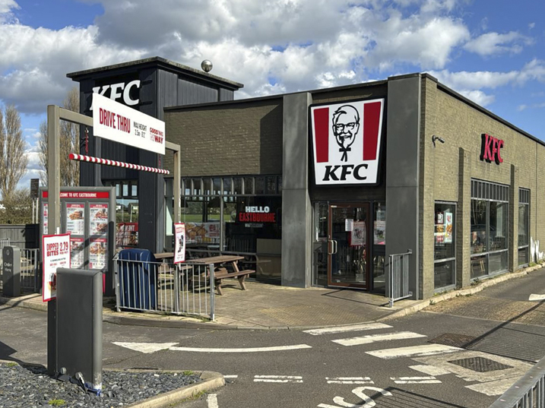
Fast Food Drive-Through Trip Generation Analysis 2023
This looked at a comparison between surveys from 2000-2011 and 2012-2022, split by weekdays and weekends.
The aim was to provide the TRICS community with clear and comparative trip generation data.
The technical analysis includes a series of comparative tables, along with a selection of observations.
The total two-way weekday trip rate for 07:00-22:00 has grown 36.6% from 2000-2011 to 2012-2022.
Notes:
Let’s start with the fast-food drive-through trip generation analysis from 2023.
It was decided to undertake a technical analysis investigating trip generation for fast food drive through developments, split by weekdays and weekends and for the periods of 2000 to 2011 and 2012 to 2022.
The aim was to provide TRICS users and the wider transport planning community with a set of clear and comparative trip generation data, with detail on the survey selection criteria and the method used in the analysis provided.
Included in the technical analysis, a series of comparative tables present the results, along with a selection of observations. Full trip rate calculation results tables can also be found in the report’s appendix.
Selecting just one observation from the technical report, the total two-way weekday trip rate for the 07:00-22:00 period has grown from 274.204 per 100m² GFA during 2000-2011 to 374.602 per 100m² during 2012-2022, an increase of 36.6%.
There are also increases over time across all weekday peak period calculations, with the total two-way peak period trip rate increasing by 23.8%.

Slide 9
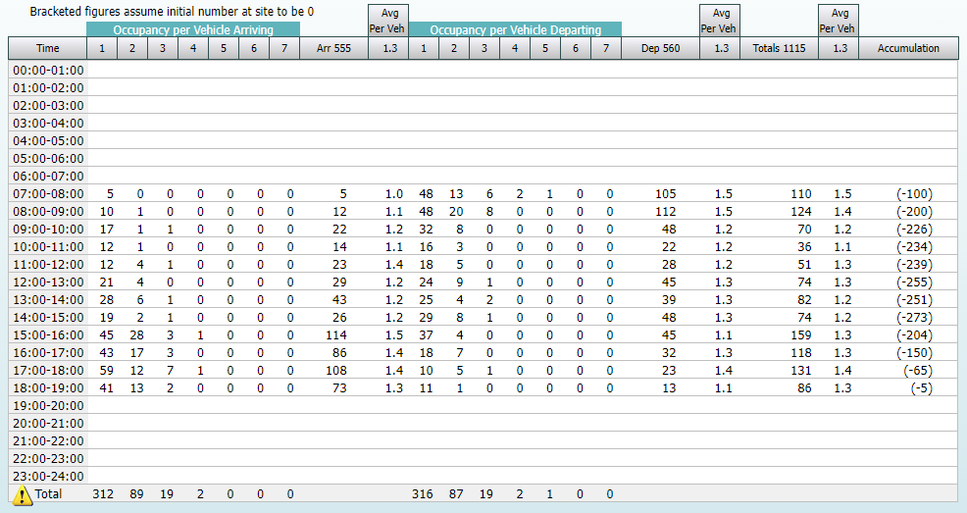
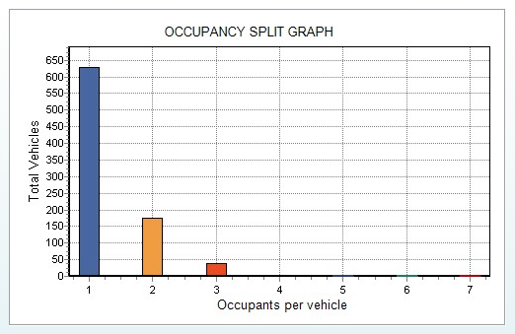
Vehicle Occupants Analysis for Selected Development Types
A Vehicle Occupants mode split was introduced to the TRICS software in 2008.
The Vehicle Occupants trip rate per 100m² GFA was 63.8% lower for the central location type group than the outer.
Notes:
Next, let’s look at a vehicle occupancy analysis for selected development types.
From 2008 the Vehicle Occupants mode split was represented in TRICS pie charts by separate “Single Vehicle Occupant” and “Multi-Vehicle Occupant” percentages.
The Vehicle Occupants count provides users with a further layer of information, as it is split by vehicles with different numbers of occupants and is also supplemented by an Occupancy Split bar chart accessible from within individual survey counts.
This document presents the results a technical analysis for eight land uses in the TRICS database, 01/A (Food Superstore), 01/C (Discount Food Store), 02/A (Office), 03/A (Houses Privately Owned), 03/C (Flats Privately Owned), 05/G (GP Surgery), 06/A (Hotel) and 07/C (Leisure Centre).
Results of the technical analysis are presented in a series of tables for each land use sub-category, showing trip rates by Vehicle Occupants, Total Vehicles, Total People, and Vehicle Occupants divided by Total Vehicles, plus peak hour trip rates and the Vehicle Occupants mode split (with a further split between single and multi-occupants).
Another table combines the land use sub-categories into a single area for comparative purposes.
Full trip rate calculation results tables can also be found in the report’s appendix.
Selecting just one observation from the technical report, for the 06/A (Hotel) land use sub-category, the Vehicle Occupants trip rate per 100m² of GFA was 63.8% lower for the Central location type grouping than for the Outer location type grouping (the figures being 7.380 and 12.088 trips per 100m² GFA).

Slide 10
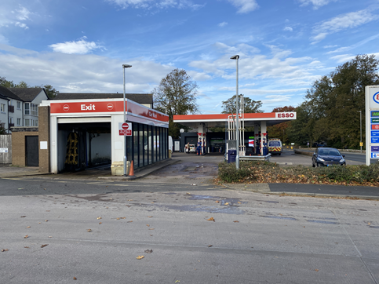
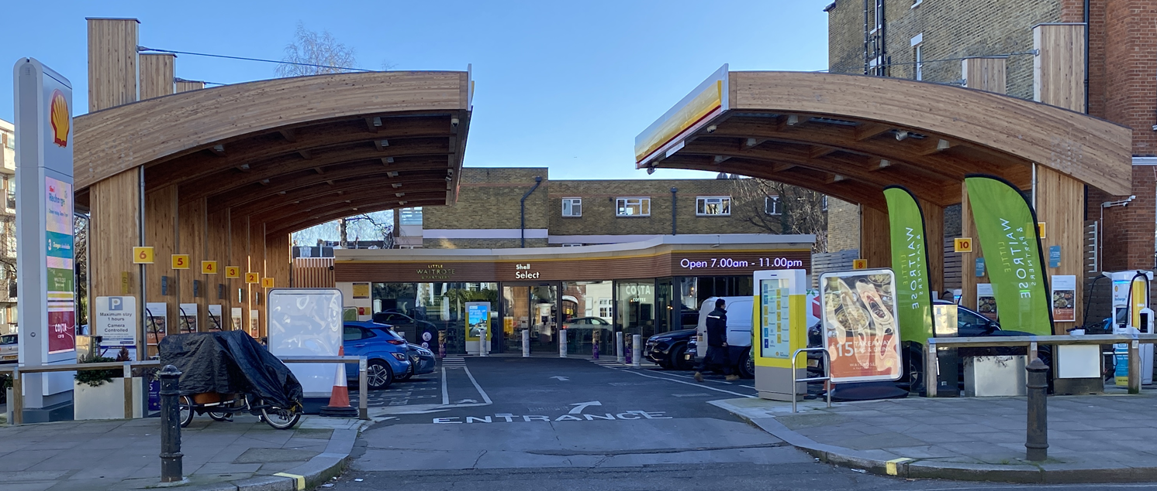
TRICS PFS Comparative Analysis
Petrol filling stations have changed significantly since the first TRICS surveys were undertaken.
This compares trip generation between the 13/A and 13/B Petrol Filling Station land use sub-categories.
The survey sample also allowed survey splits between 2000-2009 and 2010-2021, as well as by weekdays and weekends.
There are significantly lower overall trip rates for surveys undertaken during the 2010-2021 period compared to 2000-2009.
Notes:
Petrol filling stations have changed significantly since the first TRICS surveys were undertaken, so in 2022 we carried out a technical analysis comparing trip generation between the 13/A and 13/B Petrol Filling Station sub-categories.
The aim of this technical analysis was to provide some basic initial comparative information, which the survey sample was sufficient to deliver.
The survey sample also allowed survey splits between 2000 to 2009 and 2010 to 2021 periods, as well as by weekdays and weekends, with the main TRICS location types of Suburban Area, Edge of Town and Neighbourhood Centre (excluding villages) being included.
The full survey selection criteria and the method used in the analysis is provided, as well as a series of comparative tables presenting the trip rate results for 07:00-10:00, 16:00-19:00 and 07:00-19:00 time periods, with peak hour trip rates also shown.
Selecting just one observation from the technical report, there are significantly lower overall trip rates (for both sub-categories and for every investigated survey period) for surveys undertaken during the 2010 to 2021 period compared to surveys undertaken during the 2000 to 2009 period.
Looking at the Total Survey Trip Rate figures, the results show a 22.4% reduction in trip rates for the 13/A land use sub-category, and a 23.9% reduction in trip rates for the 13/B land use sub-category.
The image in the bottom right is of a Shell & Little Waitrose filling station, purely for electric vehicles, which we are hoping to gain permission for to survey later this year.
Could the introduction of these see TRICS revisit this comparative analysis in the future to see how things may have changed again for a third 10-year period between 2022-2031?

Slide 11
Other Technical Note and Report Examples
In 2022, a comparative analysis of seven residential land use sub-categories was produced.
The sub-category with the highest overall total vehicle trip rates was 03/A, followed by 03/K and 03/B.
A comparison of vehicular trip rate variation by TRICS regions and location types using the 01/A, 02/A and 03/A land uses.
No clear, consistent pattern of vehicular trip rate variation by region evident.
Notes:
A couple of other recent technical note and report examples include comparing seven residential land use sub-categories and comparing vehicular trip rate variation by TRICS regions and location types.
The intention of the technical analysis of the residential land use sub-categories was to provide some basic initial comparative information, including a split of surveys across two time periods, to allow for some time-related context.
The residential land use sub-category with the highest overall Total Vehicles trip rates (inbound and outbound combined for the 07:00-19:00 time period) was 03/A (Houses Privately Owned), with a figure of 5.312 Total Vehicle trips per dwelling for surveys undertaken from 2000 to 2010, and 4.642 Total Vehicle trips per dwelling for surveys undertaken from 2011 to 2021.
This sub-category was followed by 03/K (Mixed Private Housing) and 03/B (Affordable/Local Authority Houses).
The comparison of vehicular trip rate variation by TRICS regions and location types examines variance by looking at three of the largest and most often used land use categories in the TRICS database, these being 01/A (Food Superstores), 02/A (Offices), and 03/A (Houses Privately Owned).
The regional analysis revealed no clear, consistent pattern of vehicular trip rate variation by region evident, with variation appearing to fluctuate randomly throughout.
Harry Cook will touch on these findings in a little more detail in his presentation later this morning.

Slide 12

Technical Analysis Ideas
All five of the examples mentioned used data already
included in the public TRICS database.
Numerous options for other technical analysis ideas using
the various filters within the trip rate calculation process
There is potential to look at public transport and population levels
or variations in privately and non-privately owned dwellings.
We would be interested to hear about any technical
analyses users have carried out.
Notes:
All the technical notes mentioned in this presentation relied solely on data already included in the public TRICS database.
The examples shared here are just some of the ideas we’ve had over recent years.
There are numerous options for other technical analysis ideas using all the various filters within the trip rate calculation process.
For example, there is potential to look at public transport and population levels or variations in privately and non-privately owned dwelling numbers.
Out of interest, if anyone here has carried out their own technical analysis using the TRICS database, please could you raise your hand.
If any hands are raised, I’d like to ask if they would be happy to share the nature of the analysis.
We hope the previous few slides may be an inspiration to some of you to investigate the opportunities of having over 35 years of TRICS survey data available and we would be interested to hear about what you find.

Slide 13
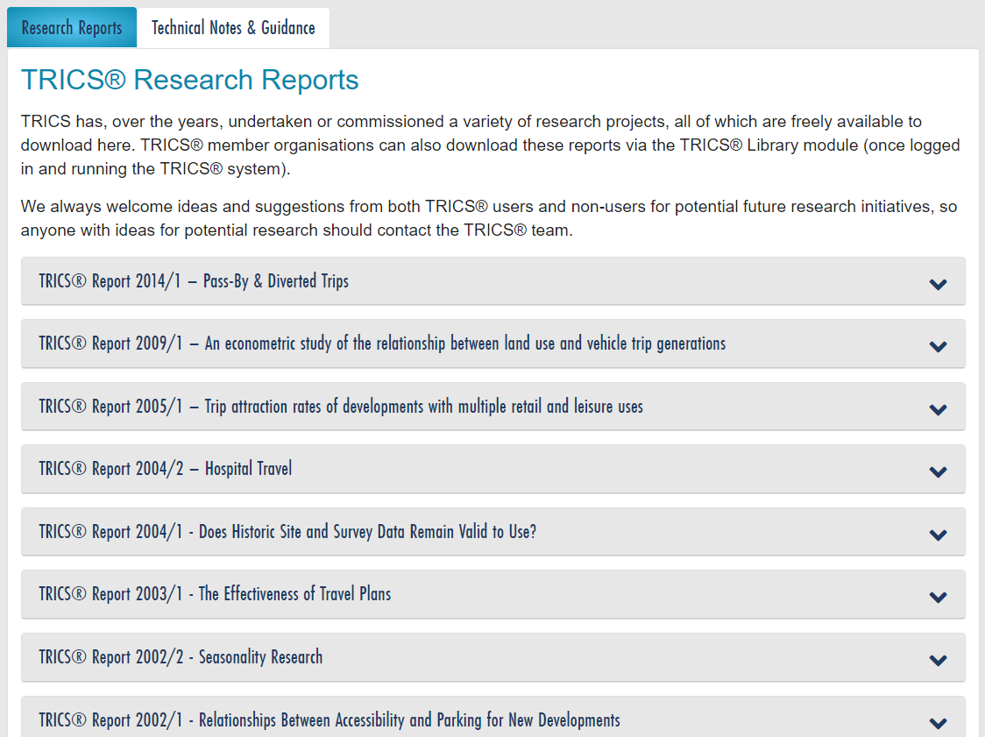
Research Reports
Notes:
Now we’ve looked at what you can do with readily available TRICS data, let’s look at what we’re currently doing to bring extra research reports to our users, with information not already in the database.
Looking at the screenshot of our website, you may have noticed TRICS hasn’t published a research report since 2014.
I’m sure everyone in this room will be pleased to hear this will soon change.

Slide 14
Servicing & Deliveries at Residential Apartments
TRICS has begun a research report project into servicing and deliveries at residential apartment developments in London.
This is an area of research that numerous members of the TRICS Community have indicated would be of significant benefit.
The study will look at three sizeable and recently fully occupied apartment developments in Central/Inner London.
Each act of servicing will be broken down into one of six servicing types and each trip’s dwell time will also be recorded.
Notes:
Only a few weeks ago, TRICS officially announced an ongoing research report project in association with Stantec.
This first research report in 10 years is looking at servicing and deliveries at residential apartment developments in London.
Stantec are taking part in this research report project in a Sponsor and Review role.
This is a new model for our research projects which we hope will lead to more frequent studies in the future, so we warmly welcome their participation.
Deliveries and servicing at residential apartments is an area of research that numerous members of the TRICS Community have indicated would be of significant benefit.
We consider it a natural progression for TRICS to move further into servicing and deliveries and obtain a deeper wealth of valuable data in this area, which is something that this research project is designed to achieve.
The study will look at three sizeable and recently fully occupied apartment developments in Central and Inner London.
Standard multi-modal TRICS surveys will take place at each development to form a good context base.
Servicing vehicles counts would normally be broken down into cars, motorcycles, LGVs, OGV(1)s and OGV(2)s, but in this study, this will be extended to include cycles (and possibly cargo bikes).
Further to this, each act of servicing will be further broken down into one of six servicing types, utility, food and drink, supermarket, courier & mail, homeware or waste and recycling.
This means that for each surveyed development there will be at least 36 sets of data that we can analyse.
In addition to this, we will also be collecting dwell time data for every vehicle and servicing type breakdown.
This will provide us with a wealth of information with which to undertake a detailed analysis and subsequently write and publish our research report, which as always will be freely available for download from our website following the project’s completion.

Slide 15
Other TRICS Research Report Projects
TRICS is not only carrying out the single research report project this year, with work on another already underway in the background.
Construction traffic is one of the most sought-after items of research that TRICS users have identified to us over recent years.
TRICS has a wealth of potential data to investigate this, by using recent SAM survey data where construction traffic was present but excluded from the survey counts.
If you have any ideas for us to look into for future research projects, you can have your say in the annual TRICS User Survey, the next one of which will be launched in early 2025.
Notes:
It may have been 10 years since TRICS published a research report but, just like your bus to work, you wait ages for one and then two come along at once.
Initial work has begun on a research report looking into construction traffic, as this is something TRICS users have continually identified to us as something of great interest.
Each year, we carry out dozens of surveys at residential developments through our independently commissioned SAM survey programme, many of which have ongoing construction at the site.
Therefore, it was an easy enough process for us to contact our TRICS approved data collection contractors and our SAM survey clients to ask for permission to use the construction traffic data in a research report and, thankfully, most of them were happy to go ahead with it.
As things progress with this piece of work, we’ll keep our users updated via our website and our social media channels, such as our LinkedIn page, YouTube channel and our Mailchimp service.
If you’re wondering how TRICS users have suggested these research ideas to us in the past, there is a section of the annual TRICS User Survey dedicated to this.
Now would probably be a good time to ask the room if you’ve ever completed the TRICS user survey, so please, if you have, could you raise your hands.
If you’ve never completed the TRICS User Survey and would like to have your say on the direction of TRICS, look out for the next User Survey coming in early 2025.
Also, if you ever have an idea that can’t wait until then, please feel free to contact us via our support@trics.org inbox at any time, as we’re always open to new ideas.

Slide 16
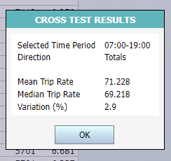
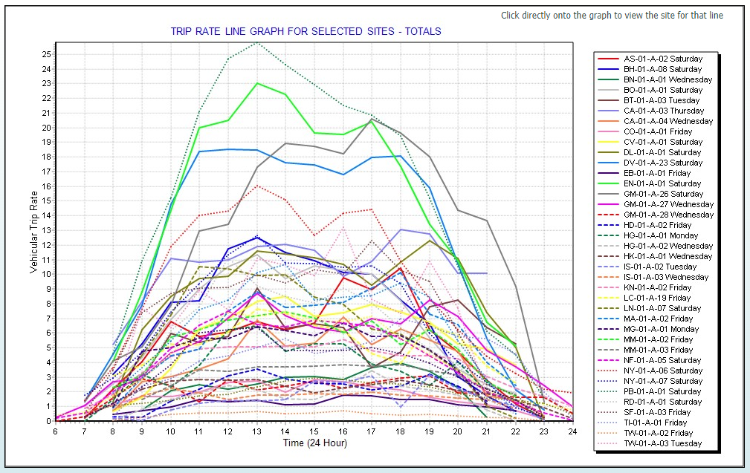
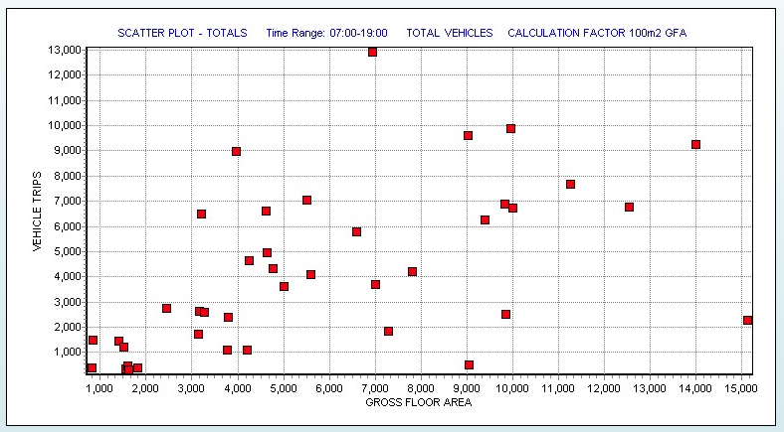
Additional Tools Within the TRICS Database
There are numerous tools within the TRICS database users may not realise they have at their disposal.
A variety of these tools will be covered in the following presentation.
Notes:
Next, let’s look at some additional tools within the TRICS database.
I’m hoping most of what you can see on the screen may be familiar to you all as tools available within the TRICS database but if you’re relatively new to TRICS, you may not recognise any of them.
Please could I ask for a show of hands if you *have* ever used any of these tools within the TRICS database?
I won’t go into much detail about them now, as the following presentation by Harry Summerfield will investigate the rank order scatterplot and cross test facility you can currently see on the screen.
I’m hoping maybe when you look at these, some of you may be thinking about the possibility of using these tools we have available in TRICS, such as the rank order scatterplots and the cross-test facility, and the potential there is to use them as a comparative tool between datasets.

Slide 17
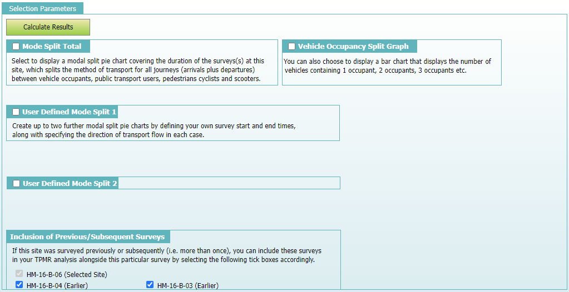
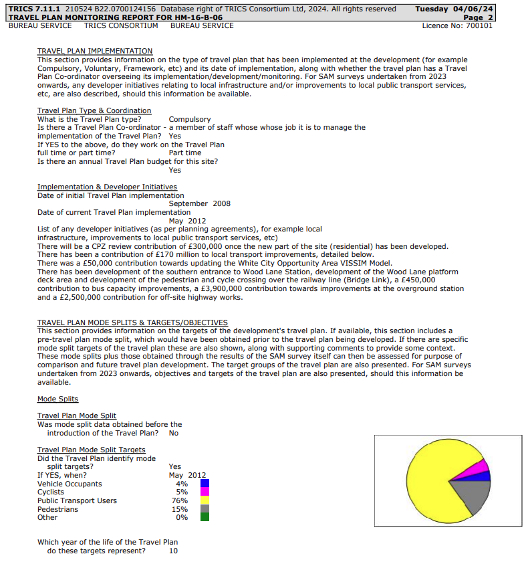
Travel Plan Monitoring Report Facility
Another tool which TRICS users can utilise is the Travel Plan Monitoring Report Facility within the Travel Plan section of a TRICS SAM survey.
Notes:
The idea of the TRICS Travel Plan Monitoring Report facility (or TPMR) is to provide a quick and easy method by which TRICS users could produce a Travel Plan Monitoring Report, to include key information on individual SAM surveys.
These reports also include automated explanatory commentary provided throughout the report, designed so those who aren’t familiar with TRICS can read through the document and find it easy to understand.
Again, I won’t go into too much detail about this facility or how it works as Harry Summerfield will be speaking in slightly more detail about it in the following presentation.
Harry also did a full 20-minute presentation on the revised TPMR facility at one of our user events last year and the slides of this can be found on our website to download, if you’re interested to learn more.

Slide 18
Bespoke SAM Surveys
As well as our annual regional survey programme of over 250 surveys per year, TRICS also carries out independently commissioned surveys every year.
Most of these surveys fit into a regular TRICS survey methodology but there are some which we need to adapt our methodology for, due to the size and/or nature of the site.
Notes:
Whilst we’re talking about SAM surveys, I’d like to let everyone here know we up for any challenge when it comes to a TRICS survey.
On top of the 250 or so regional surveys we carry out each year, we also carry out over 50 independently commissioned SAM surveys.
Whilst most of the SAM surveys we carry out each year fit our regular TRICS Multi-Modal methodology, there are some where we need to adapt it.
The most obvious examples of this are the Westfield London and the Wembley Park surveys we’ve carried out in recent years.
If you’re interested to learn more, I did a presentation on the massive Wembley Park survey at November’s User Meeting in 2023 and this can be downloaded from our website.
Also, SAM surveys at the Westfield London development in Shepherd’s Bush have taken place four times now with an adapted survey methodology that does not compromise the integrity of the survey results and all four of these can be found in the TRICS database in the 16/B Mixed Use land use site list.
Once again, could I please see raised hands for those of you who were already aware TRICS can carry out *bespoke* independently commissioned surveys that wouldn’t necessarily be possible by following the standard TRICS Multi-Modal methodology?

Slide 19
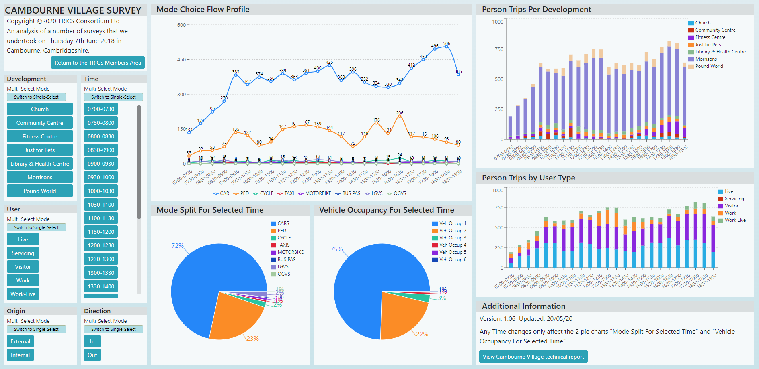
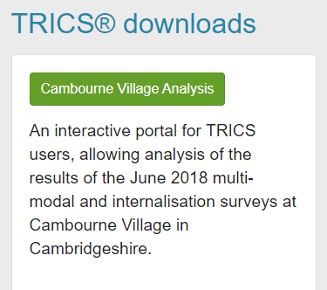
Cambourne Analysis Tool
One of the most bespoke TRICS surveys ever carried out was at the village of Cambourne.
Within the TRICS Members Area, the Cambourne Village Analysis tool can be found.
Notes:
Finally, I’d like to speak about a survey we did back in 2018, which was a highly bespoke survey at the village of Cambourne, not far from Cambridge.
This survey used the standard TRICS Multi-Modal Methodology but, at the same time, we were interested to see the levels of internalisation present at several of the key on-site developments, such as the Morrisons food superstore, the fitness centre, the church, the community centre, etc.
The survey was so large, it required two data collection contractors to come together to work on different aspects of collecting what was required on the survey day.
Due to the uniqueness of the internalisation part of the survey, we needed a way to present this to our users and so we created the Cambourne Village Analysis tool.
This tool can be found in the TRICS Members Area when logging in with your regular username and password but, before clicking the TRICS 7.11.1 button, scroll down the page towards the bottom and this is where the tool can be launched.
The analysis tool allows the user to look at all the different on-site developments which were surveyed for levels of internalisation, as well as being able to adjust the time periods, origin and direction of trips, and the journey purpose, such as visiting, for work, or servicing.

Slide 20
TRICS is just a trip rate calculation
tool, right?
Wrong!
Notes:
To close, I’d like you to think back to the beginning of the presentation and whether you thought TRICS *was* just a trip rate calculation tool.
If you did, I hope this presentation has changed your mind!
If you have any questions about anything mentioned in the presentation, I’ll welcome your questions in the Q&A session following the next two presentations.

